Slide 1


PROFLENS AUC
Professor & Course Review Platform
Made by AUC Students, for AUC Students
Completed By:
Youssef Elmahdy - 900212370
Mariam Shoukry - 900221804
Youssef Anan - 900211132

Slide 2

Introduction
What is ProfLens AUC?
A full-stack web application that enables students at the American University in Cairo to:
Discover and search professors and courses
Submit and view detailed ratings and reviews
Compare quality across departments and semesters
Make informed academic decisions
Live hosted Website can be found at:
https://proflens-auc-frontend.vercel.app

Slide 3

Motivation & Problem Statement
AUC students need a reliable, centralized source of professor/course feedback
Existing review systems are scattered or outdated
Goal: Modern, responsive interface with real-time data, secure auth, and deployable cloud backend

Slide 4
KEY FEATURES
Secure Login & AUC email validation
Browse professor profiles with ratings
Filter/search courses & professors
Submit honest reviews (anonymous/attributed)
Helpful voting + reporting system
Real-time search suggestions

Slide 5

User Authentication & Sessions
JWT-based authentication for secure sessions
AUC-email restriction (e.g., @aucegypt.edu)
Persistent session state via token storage
Protected routes for sensitive actions
Role-based access (Admin & Student)

Slide 6


Frontend (React)
Architecture Overview
React 18, Tailwind CSS, Axios
Context API for auth state
Protected routes & error boundary
Backend (Node/Express)
REST API with secure endpoints
JWT auth, input validation, CORS
MongoDB + Mongoose ODM
Cloud Hosting
Vercel (Frontend + backend as serverless functions)
MongoDB Atlas for database

Slide 7


Frontend & Backend Integration
Axios with interceptors attaches JWT tokens
Context API manages auth across routes
Live data replacing mock UI
Seamless CRUD interactions between client and backend
Error handling across UI and API
Dynamic state updates after actions (e.g., review submission)

Slide 8

Tech Stack
Frontend:
React 18, React Router, TailwindCSS, Axios
Backend:
Node.js, Express, MongoDB, Mongoose, bcryptjs, JWT
Deployment & Tools:
Vercel (serverless deployment)
MongoDB Atlas
GitHub repository & CI/CD workflows

Slide 9

Deployment
Cloud Hosting Choice: Vercel
Easy Git integration & CI/CD
Supports serverless backend functions
Fast global content delivery
Auto HTTPS and previews with each push
Status: Frontend and backend live and accessible

Slide 10

Database & API Design
Collections: Users, Professors, Courses, Reviews
RESTful endpoints for CRUD operations
Search API endpoints for real-time lookups
Auth endpoints for secure token flow
Health check endpoint for uptime monitoring

Slide 11
SECURITY FEATURES
Password hashing using bcrypt
Input validation via express-validator
Helmet for secure headers
Rate limiting on sensitive endpoints
CORS configuration for controlled access

Slide 12
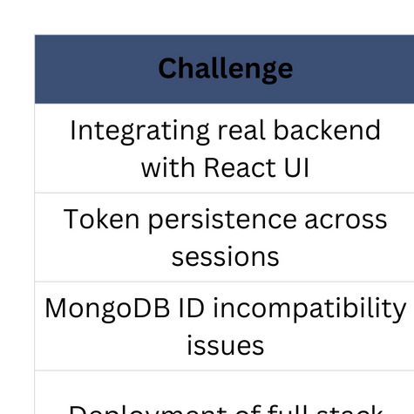

Challenges & Solutions

Slide 13
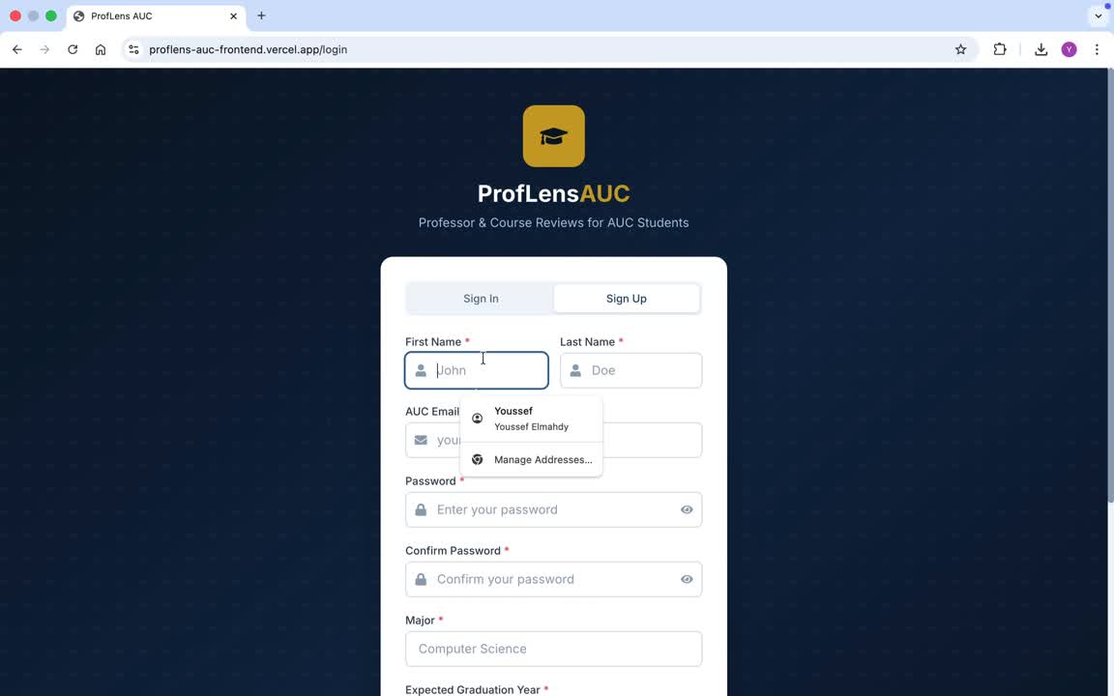
Demo Video

Slide 14
Future Work
Add social login (Google/Microsoft)
Rating trends & analytics dashboard
Mobile app version
Recommendation engine for Courses/Professors

Slide 15

Conclusion
Fully deployed, integrated full-stack solution
Secure authentication + session management
Scalable cloud deployment on Vercel
Real, useful platform for AUC students

Slide 16
THANK YOU
For your attention

